Slide 1
A Fast Algorithm for Liquid Democracy Problem

Slide 2
Introduction
Voting
system
Low participation
Blackbox Operation
democracy
Liquid Democracy
Blockchain

Slide 3
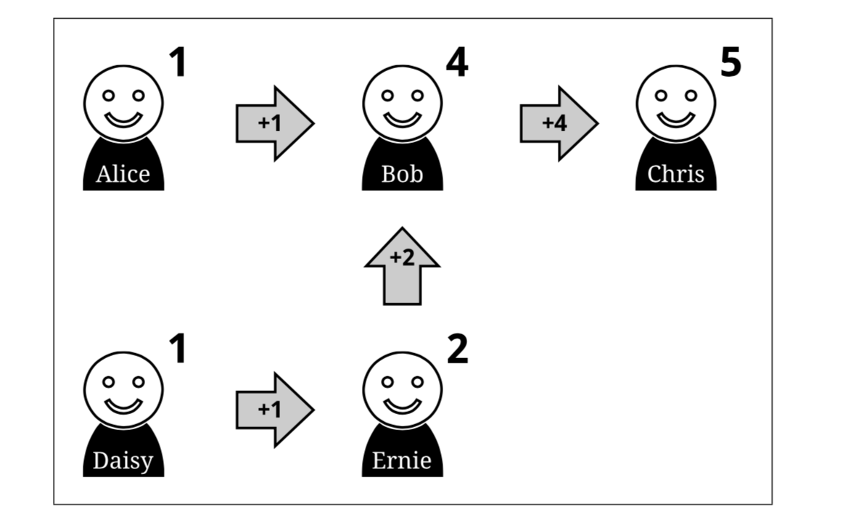
Liquid Democracy
Each voter can select a proxy for his vote
The proxy can further delegate to other people
Creating a (direct) delegate graph
Whenever a delegate votes to a candidate, all his delegators’ (including multi-level) voting powers are also cast to that candidate.
If the delegator dislikes the way in which the proxy voted, they can either vote themselves or pick another delegate for the next vote.

Slide 4
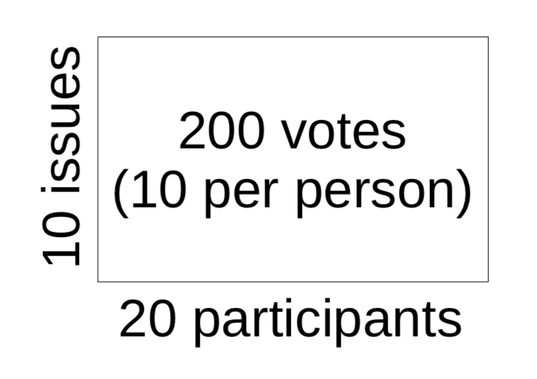
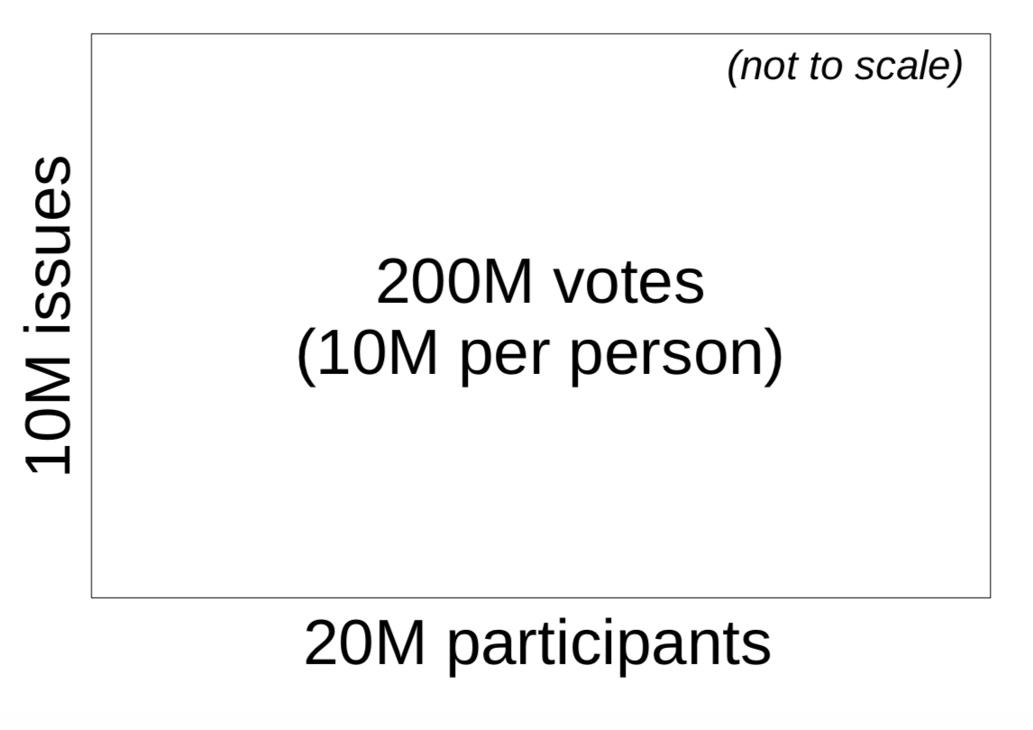
Why Liquid Democracy
Saving time in direct democracy:
Do not have time for fully participation
Can not become expert on every issue.
Ask a friend who knows more.
Get opinion of a trusted expert.
Pure direct democracy may work for a small group...
Liquid democracy allows voters to delegate to different representatives in different areas.
Delegate health issues to my doctor friend
Delegate technology issues to geek friend

Slide 5
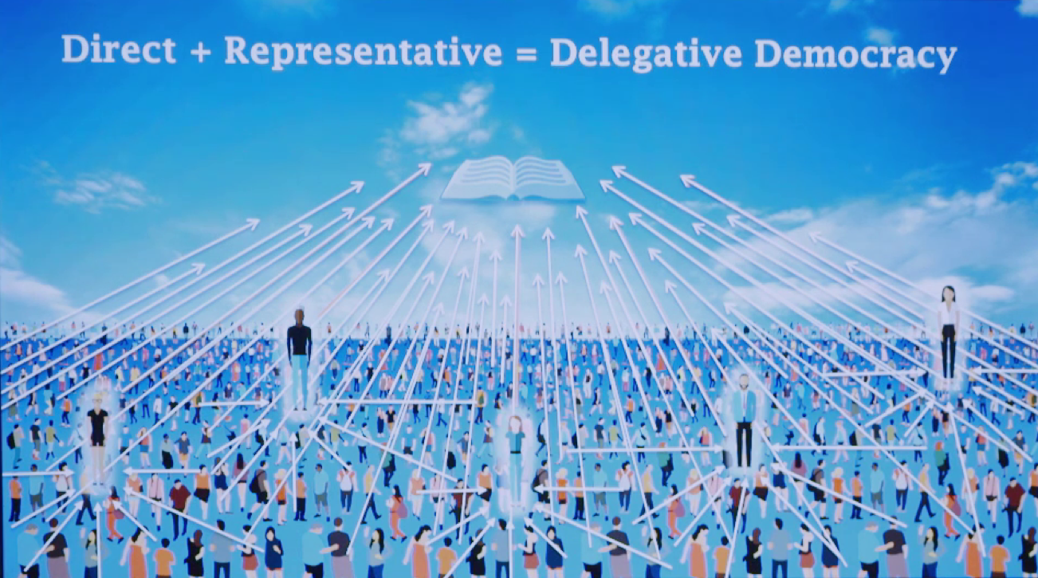

Slide 6
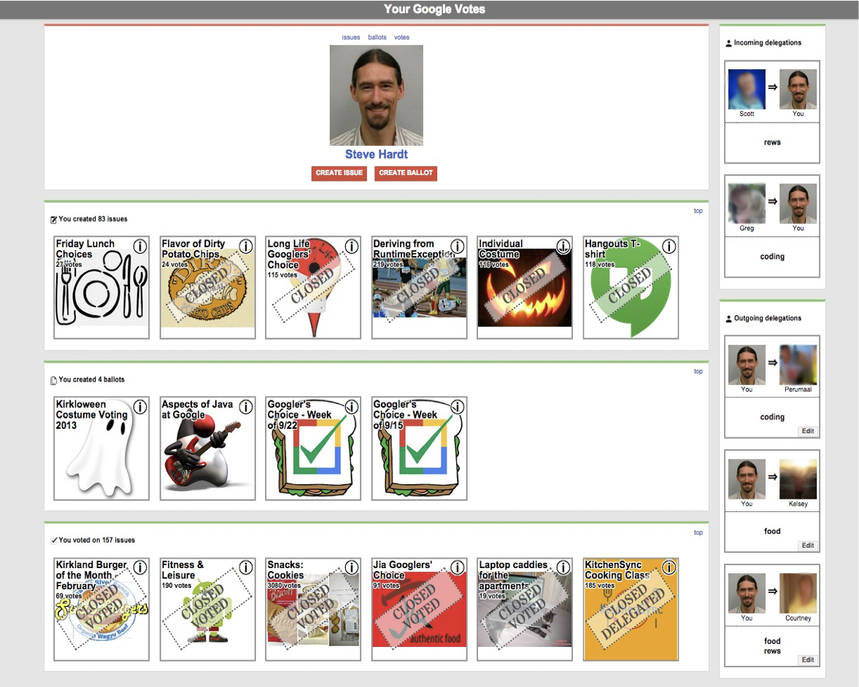
Applications
Google vote Liquid Feedback

Slide 7
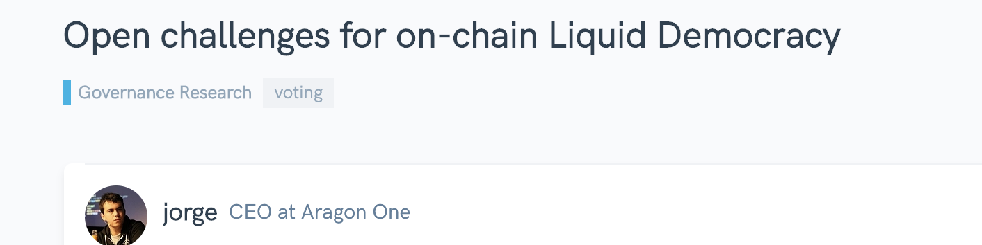
Blockchain
Decentralized and immutable public ledger
Voting system can be deployed through smart contract
Safe, reliable, transparent
Challenge: gas fee limitation
Executing of single instruction of smart contracts consumes gas,
Total consumed gas bounded by Block_gas_limit
Number of instructions less than 1000
Remains open

Slide 8
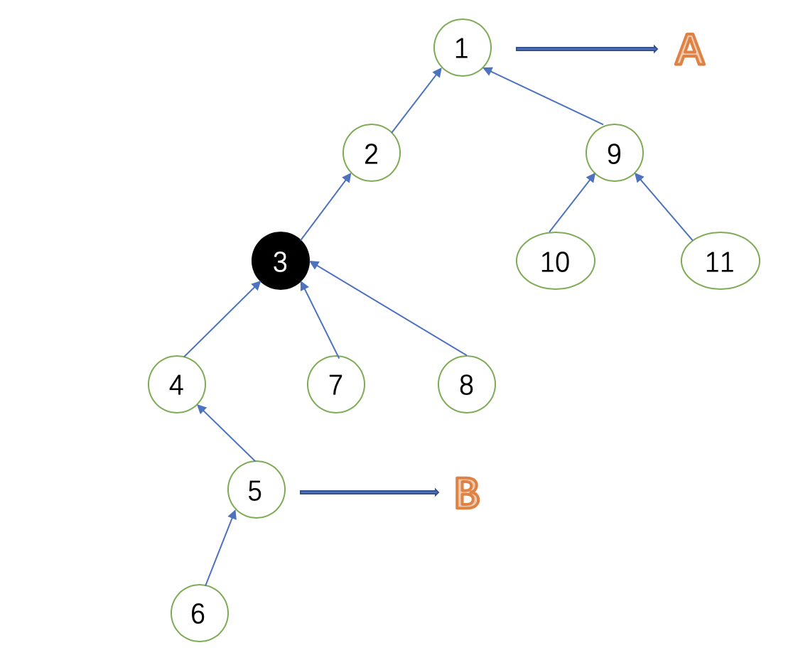
Difficulty: real-time self tally requirement
Suppose 3 votes,
two critical information need:
Actual voting power:
5’s vote reduces 3’s voting power
Vote change to other candidate
3’s vote reduce 1’s voting power
Thus A’s votes are decreased:
Traditional algorithm: forward and backward traversal to obtain the information
O(n) time complexity → n<1000 in practice

Slide 9
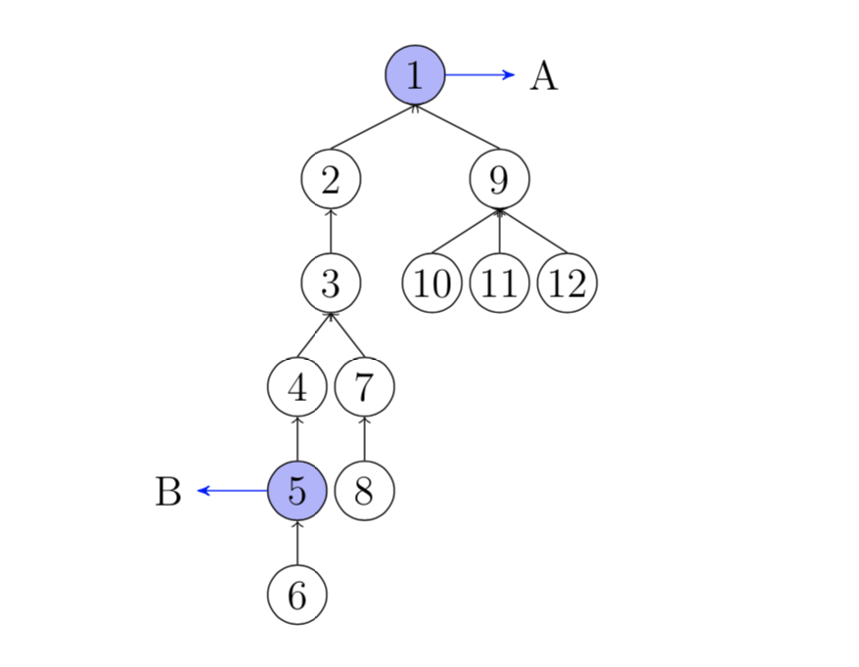
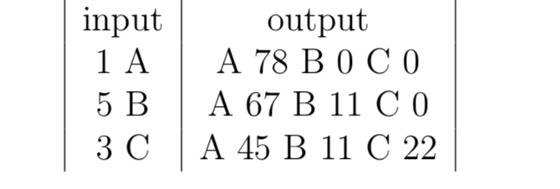
Example
Suppose voter i’s voting power is i
1 votes for A, A increases 78
5 votes for B, B increases 11, A decreases 11
3 votes for C, C increases 22, A decreases 22
Goal: real-time displaying voting status

Slide 10
Our contribution
O(log n) on-chain time complexity processing each voting massage
O(n) off-chain time complexity for initialization
Initiation data is submitted to the contract together with the voting massage, and is check with O(log n) time complexity

Slide 11
Preliminary: Problem
n voters, indexed by 1,2,.,..n, m candidates, indexed by A,B,C
Spare period: voters can arbitrarily delegate, undelegate and change delegate.
Prepare period: a holder deploys a voting contract, the delegate graph need to be construct, and each voter’s voting power is determined
Voting period: each voter can send direct voting massage, the voting status need to be updated and displayed according to the rule of liquid democracy.
Voter can not change his delegate in this period

Slide 12
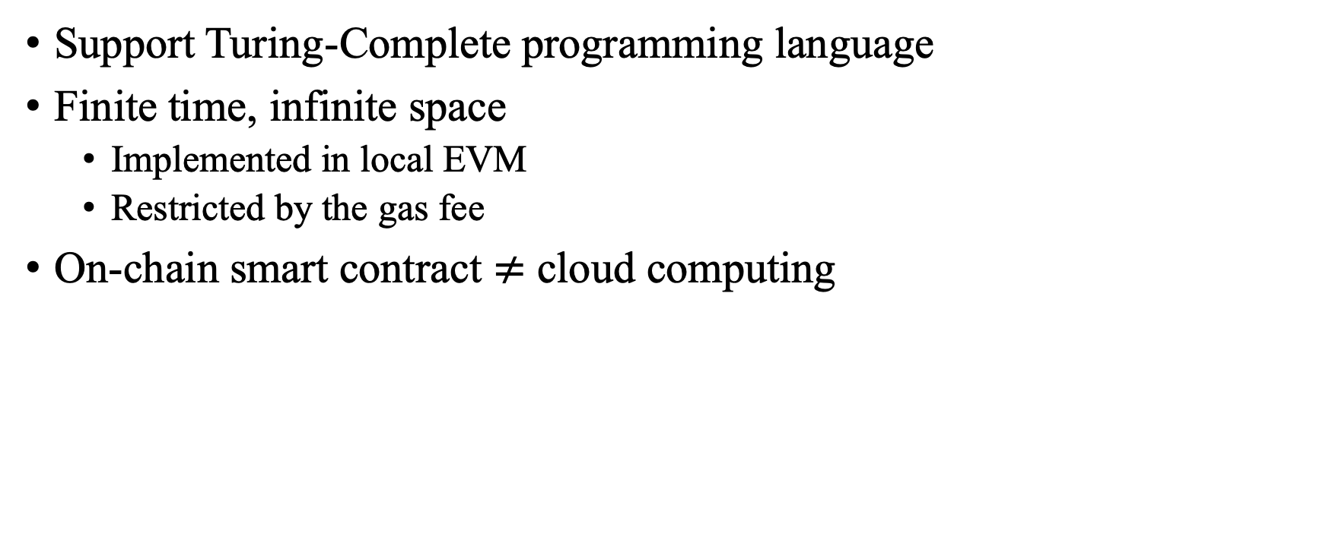
Preliminary: smart contract
Support Turing-Complete programming language
Finite time, infinite space
Implemented in local EVM
Restricted by the gas fee
On-chain smart contract $≠$ cloud computing

Slide 13
Preliminary: Merkel Tree
Hash function h()
Cryptographically hard for inverse
Node’s value: Hash value of the Combination of child nodes
Merkel proof (path):
The brother nodes of the path from a leaf to the root
For data A, proof is (h_{B},h_{CD})
ROOT=h(h_{AB}||h_{CD})
h()
h_{AB}=h(h_{A}||h_{B})
h_{CD}=h(h_{C}||h_{D})
h()
h()
h_{A}
h_{B}
h_{c}
h_{D}

Slide 14
Preliminary: Interval Tree
Each node represents an interval
Root indexed 1, for node k, two children indexed 2k, 2k+1
Use: maintain an array, where the opeation is to a successive interaval
Update a interval:
Begin at the root, execute recursively
Sperate to sub-intervals such that belongs to the interval of current node
Recursion ends when the interval to be update equals to interval of current node
Recorded by lazy-tag, which means that it is temporarily suspended and will be executed in subsequent operations
O(log n) time complexity

Slide 15
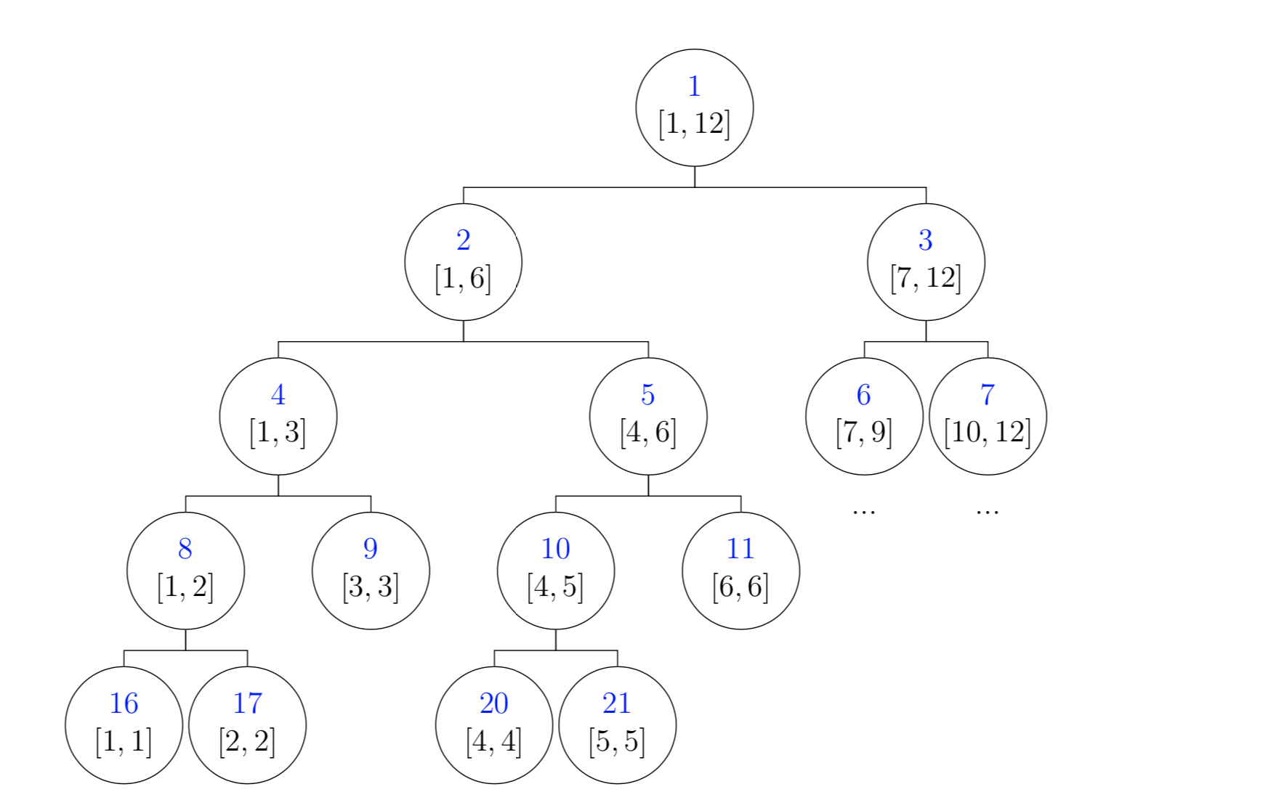
[3,12]
Update [3,12]
[3,6]
[7,12]
Lazy-tag
[3,3]
[4,6]
Lazy-tag
[3,3]
Update

Slide 16
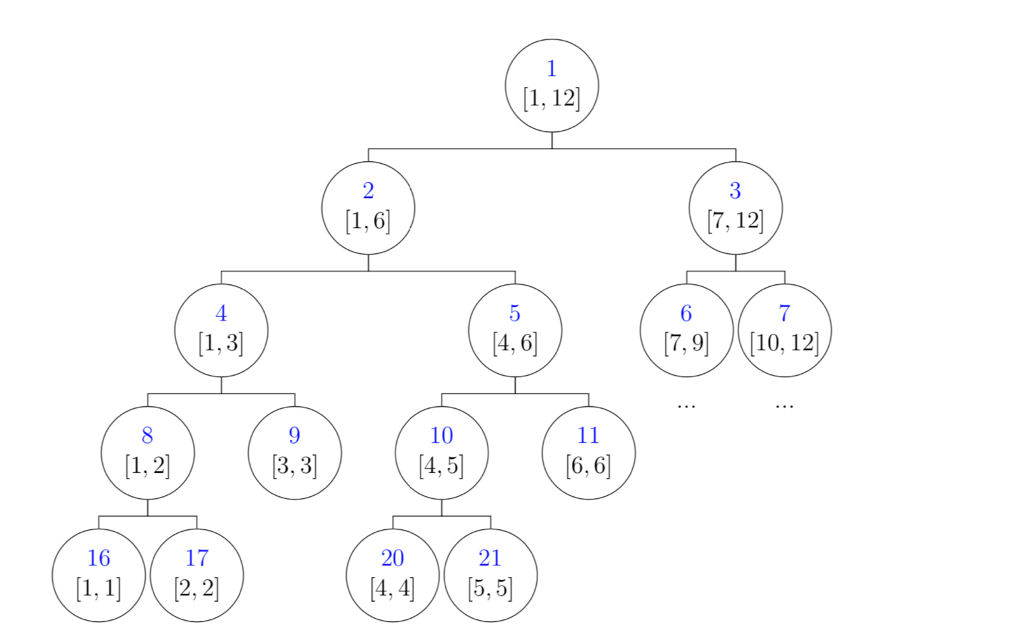
5
Find 5
Lazy-tag
Lazy-tag
Lazy-tag
Lazy-tag
Update

Slide 17
Algorithm: Overview
Maintain the “lost voting power” (LVP)
Actual power=total voting power-LVP
1 votes, nobody LVP change
5 votes, B’s vote +11, voter 2,3,4’s LVP-11
3 votes for C, C’s vote+22(3+…+8-11), 2’s LVP-22
Observation: when a vote votes, nodes’ LVP need to be updated if and only if it is on the path from the voter to the voter’s nearest voted parent (NVP)
When 5 votes, path (5)→4→3→2→(1) should update LVP
When 3 votes, path (3)→2→(1) should update LVP

Slide 18
Core
1. Find the node’s NVP
2. Update the LVP on the path
Solution: interval tree, w.r.t.
Preorder sequence: 1 2 3 … 12
Bracket sequence: 1 2 3 4 5 6 6 5 4 7 8 8 7 3 2 9 10 10 11 11 12 12 9 1
Off-chain initialization
Preorder index, total voting power, index of the bracket sequence
Submit to the contract together with voting message.

Slide 19
Spare Period
Delegate contract always exists
Delegate(): appoint to a proxy
Protocol: Locally check whether there is a cycle. If yes, change your proxy
Vote(): start a voting, deploy a new voting contract

Slide 20
Prepare Period
For each voter involved in the voting:
Snapshot the blockchain by the current height
Construct the delegate tree T
For a cycle, delete the latest edge
Link each zero-outdegree node to a virtual node
Obtain voters’ voting powers by their stakes from the snapshot
Call Preorder(T.root) for initialization data
Construct the Merkel tree for each voter’s initialization data
For the holder:
Hardcode the Merkel root in the voting contract

Slide 21
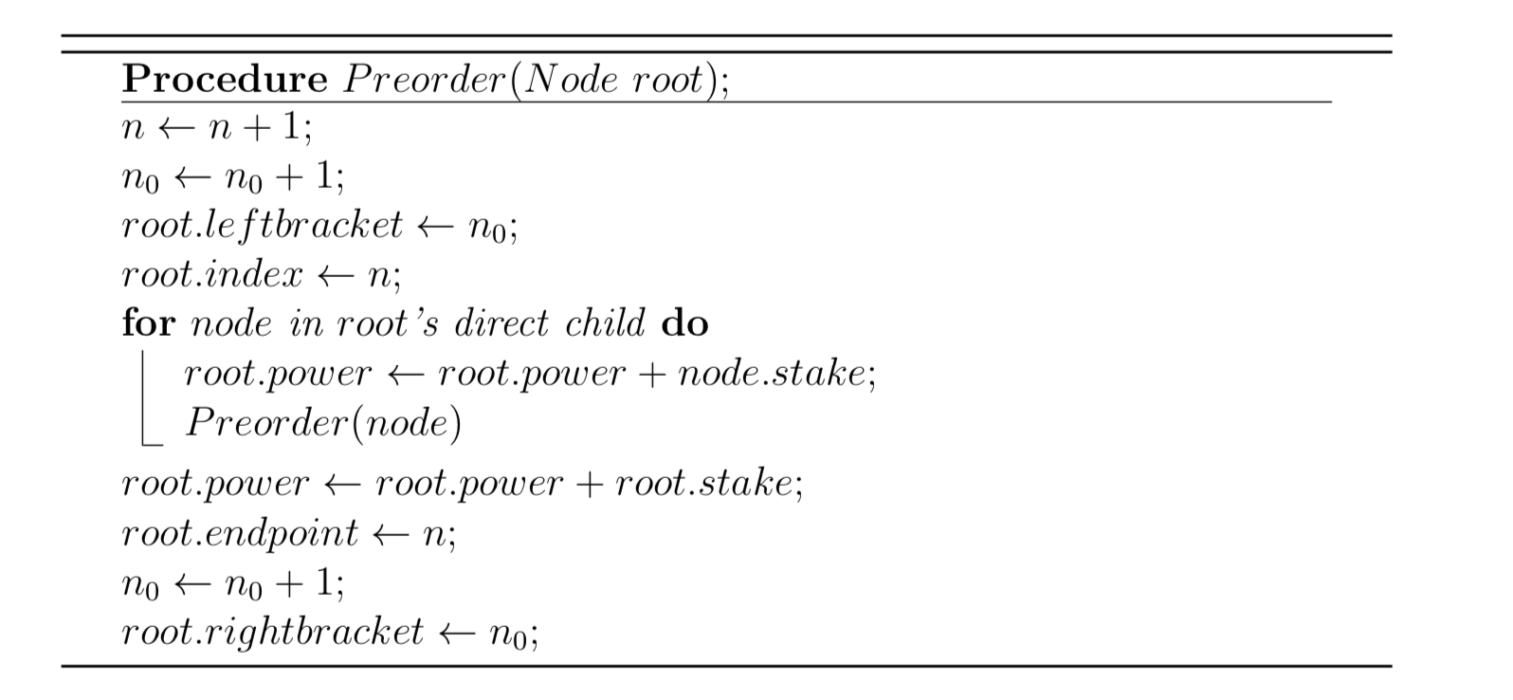

Slide 22
Voting Period: main function
For voter: send a voting massage, together with his initialization data
For voting contract: upon receiving a voting massage:
Check the availability
Compute the voter’s LVP
t = voter’s total voting power minus LVP, represents his actual votes.
Find the voter’s NVP, and then update other voters’ NVPs
The candidate of the voter’s NVP decreases by t.
Update the LVPs of the nodes on the path from the voter to the voter’s NVP.

Slide 23
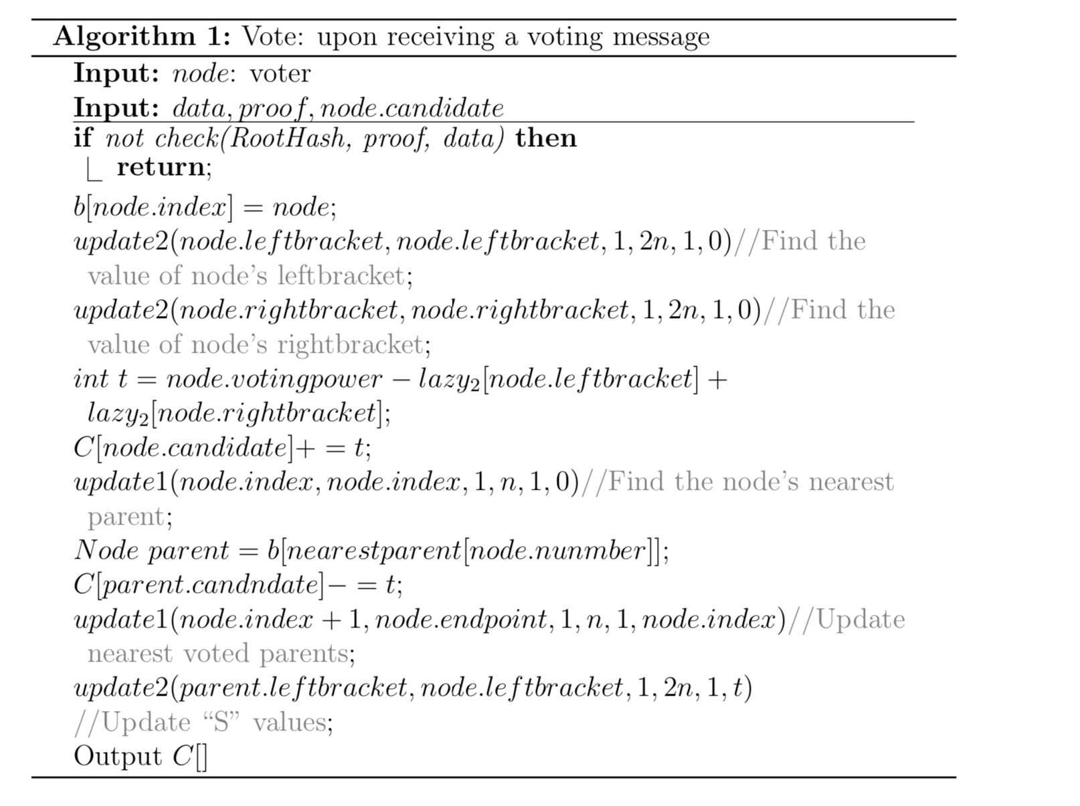

Slide 24
Find the NVP
Observation
A node’s preorder index is always smaller than its children’s.
Preorder indexes of a node’s children are successive to the node’s preorder index.
When a voter votes, only his children’s NVP need to be updated, which should be at least the voter’s preorder index.
Maximum value update w.r.t. to the interval of the node’s children
When 3 votes, use 3 to update 4,5,6,7,8’s NVP.

Slide 25
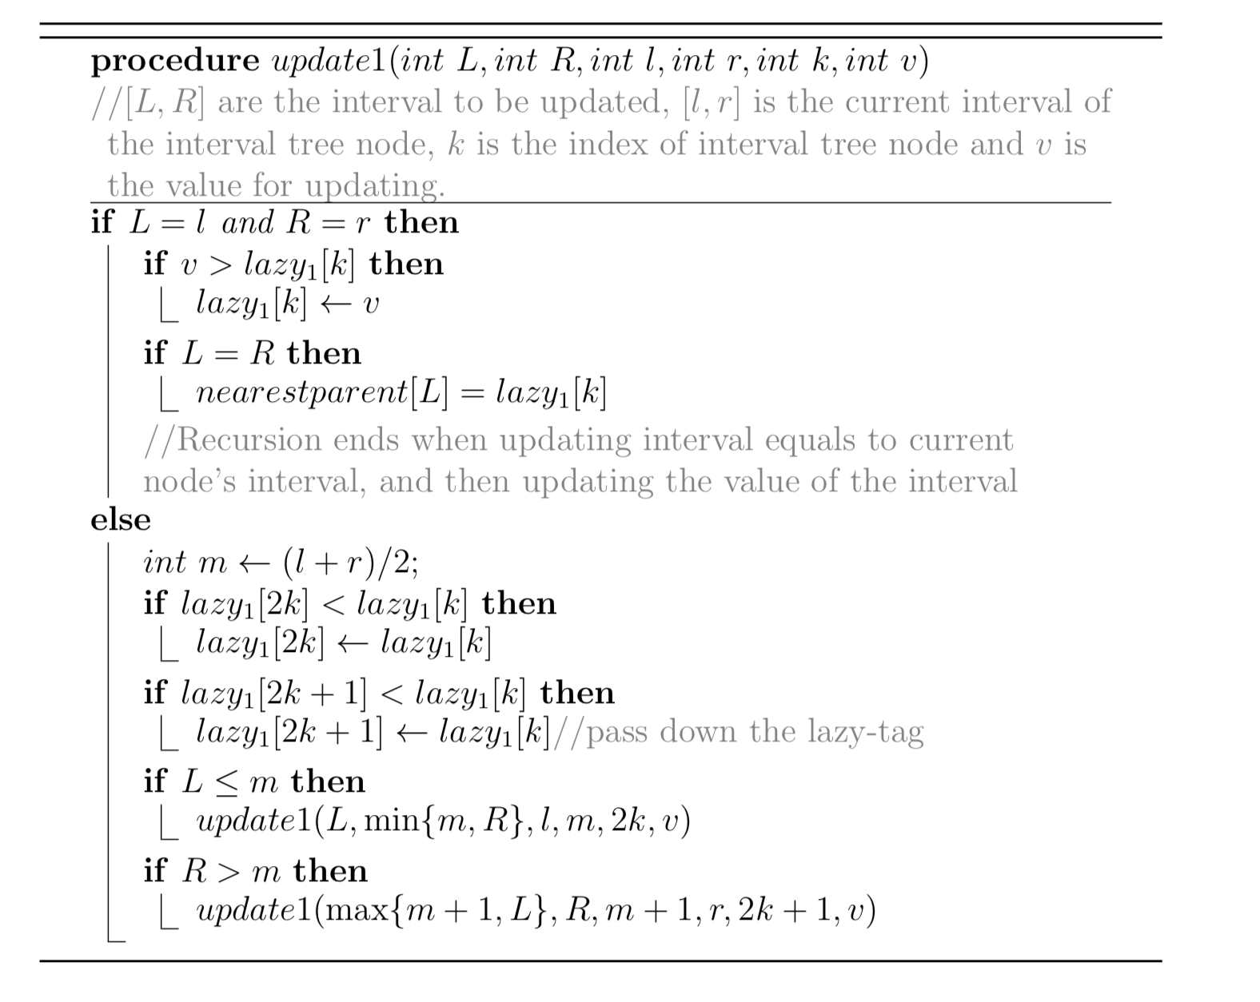

Slide 26
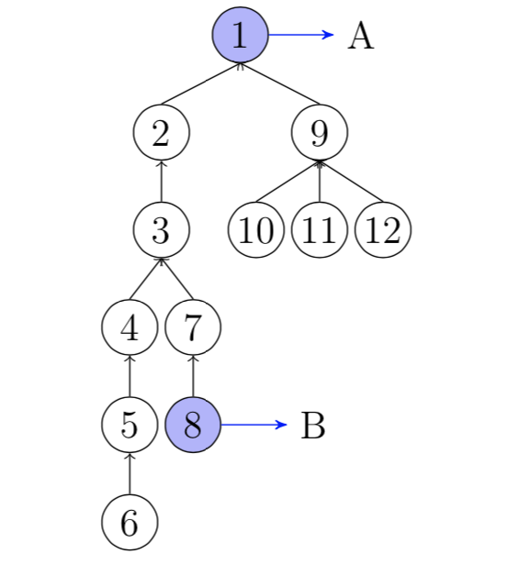
Update the LVP
When 8 votes, path (8)→7→3→2→(1) should update
Not successive
Use bracket sequence
Bracket sequence:
1,2,3,4,5,6,6,5,4,7,8,8,7,3,2,9,10,10,11,11,12,12,9,1
Bracket interval:
[End point’s leftbracket, Start point’s leftbracket]
For 8->1, Bracket interval is index 1-11
1, 2, 3, 4, 5, 6, 6, 5, 4, 7, 8

Slide 27
Update the LVP (cont’)
Observation: for nodes on the path, they occur exact once in the bracket interval; for node outside the path, they occur twice of do not occur
Update LVP by adding the value to the “s” value of the bracket interval
Only the node on the path increases LVP
When 8 votes, s[1-11]+=8
Interval tree w.r.t. the bracket sequence
1, 2, 3, 4, 5, 6, 6, 5, 4, 7, 8
node.LVP = s[node.leftbracket] − s[node.rightbracket]

Slide 28
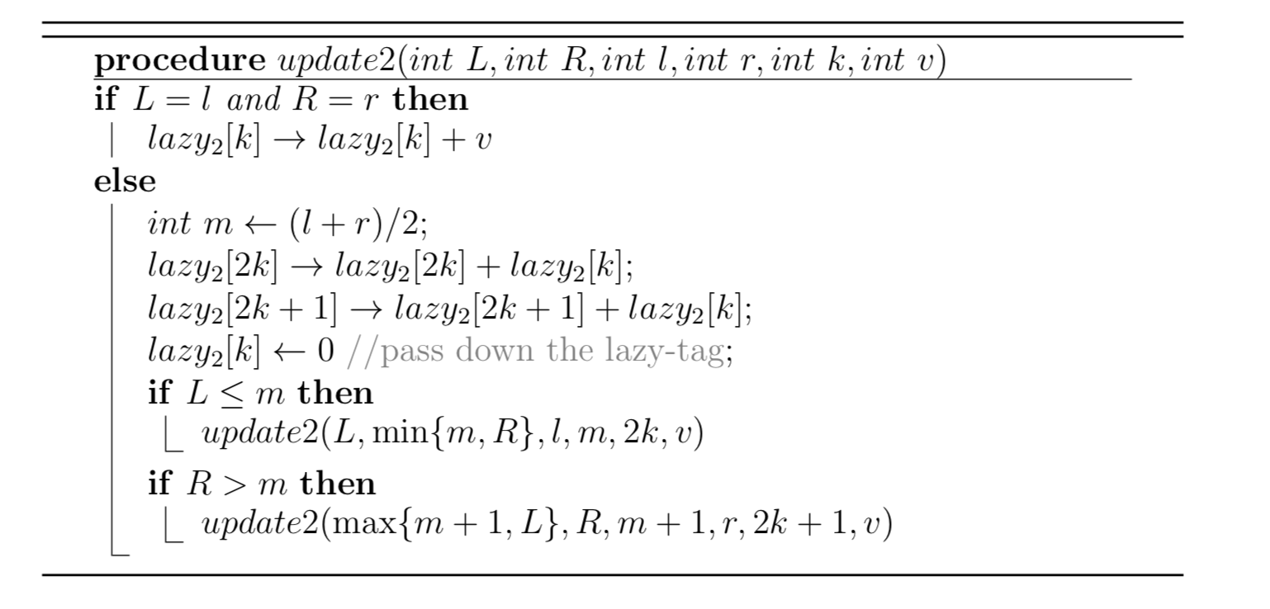

Slide 29
Lemma 1
If a voter’s delegate operation does not generate a cycle of the delegate graph (locally checked), then the corresponding edge will never be deleted.
If a voter deviates from our mechanism, by sending a delegate edge that generates a cycle, then further, this edge will not cause other voter’s delegate edge to be refused if they follows the protocol.
A
B

Slide 30
Theorem
For each voting massage in liquid democracy problem, the voting status can be updated and displayed within O(log n) time complexity. Moreover, our algorithm can be deploy on the Ethereum mainnet and overcome the gas limitation, for the number of voters more than one million.
Processing a voter’s voting message does not rely on the initialization data of other voters that has not voted
The “mapping” structure in Solidity (the coding language of Ethereum smart contract) satisfies that, the storages are allocated only if they are assigned values
Lazy[3] can be allocated without the allocation of Lazy[1] and Lazy[2]

Slide 31
Experiment
Random graph, random voting order.
• Chain, forward and backward voting order. • Star graph (no delegation) any voting voter.
n ranges from 10 to 1000000
Record the maximum consumed gas among voting messages.

